Slide 1



Digital Electronics
Class X
lab 20

Slide 2
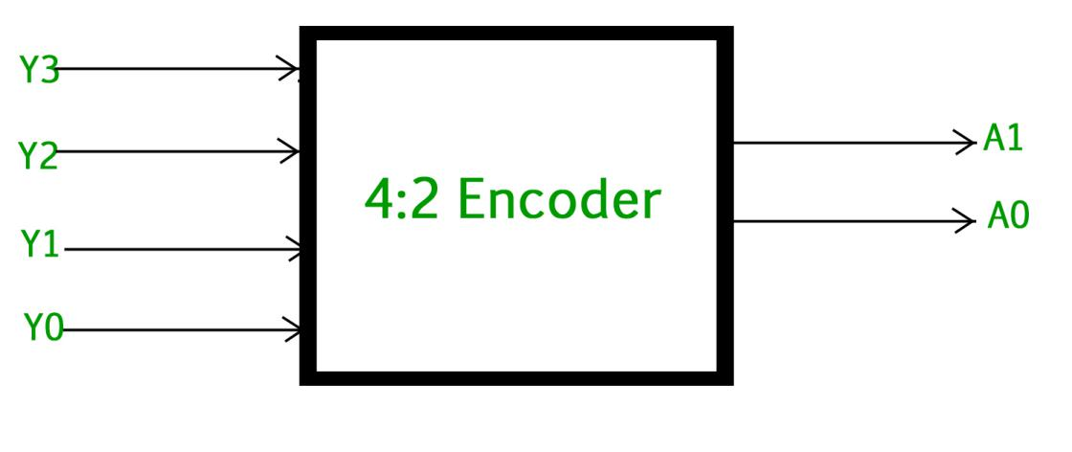
Enecoder
combinational circuit that performs the reverse operation of Decoder

Slide 3
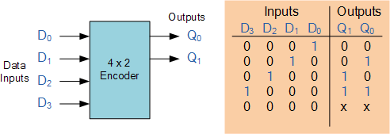
Inputs and Outputs for Encoder

Slide 4
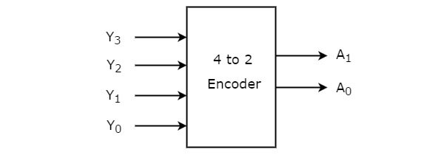
4 to 2 Encoder
Let 4 to 2 Encoder has four inputs Y3, Y2, Y1 & Y0 and two outputs A1 & A0. The block diagram of 4 to 2 Encoder is shown in the following figure

Slide 5
Truth table of 4 to 2 Encoder
Inputs |  |  |  | Outputs
Y₃ | Y₂ | Y₁ | Y₀ | A₁ | A₀
0 | 0 | 0 | 1 | 0 | 0
0 | 0 | 1 | 0 | 0 | 1
0 | 1 | 0 | 0 | 1 | 0
1 | 0 | 0 | 0 | 1 | 1

Slide 6
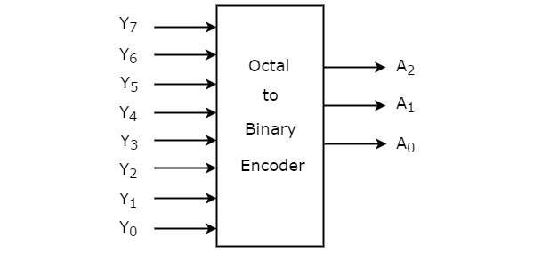
Octal to Binary Encoder
8 inputs and
3 outputs

Slide 7
Thank You

